Slide 1
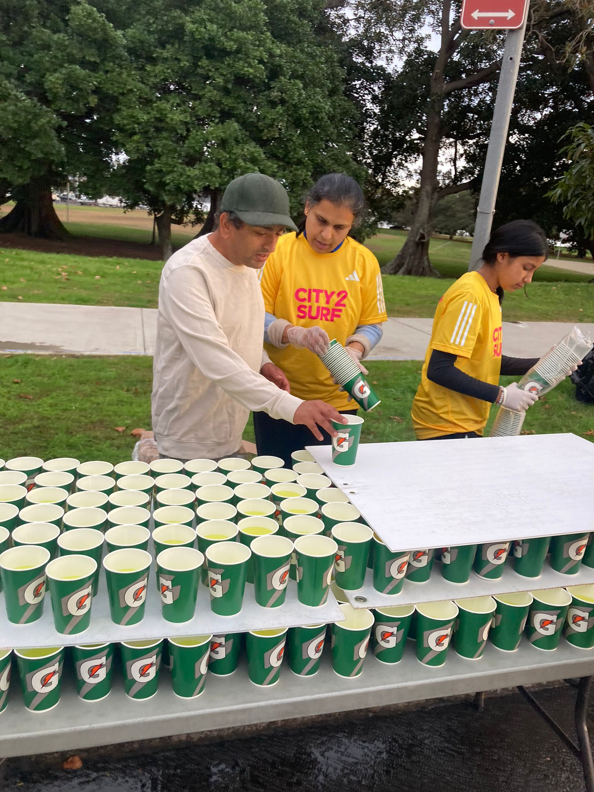
Presentation to Clarke Rd, School 30 July 2014 Sid Chandran
Reflecting on My Education

Slide 2
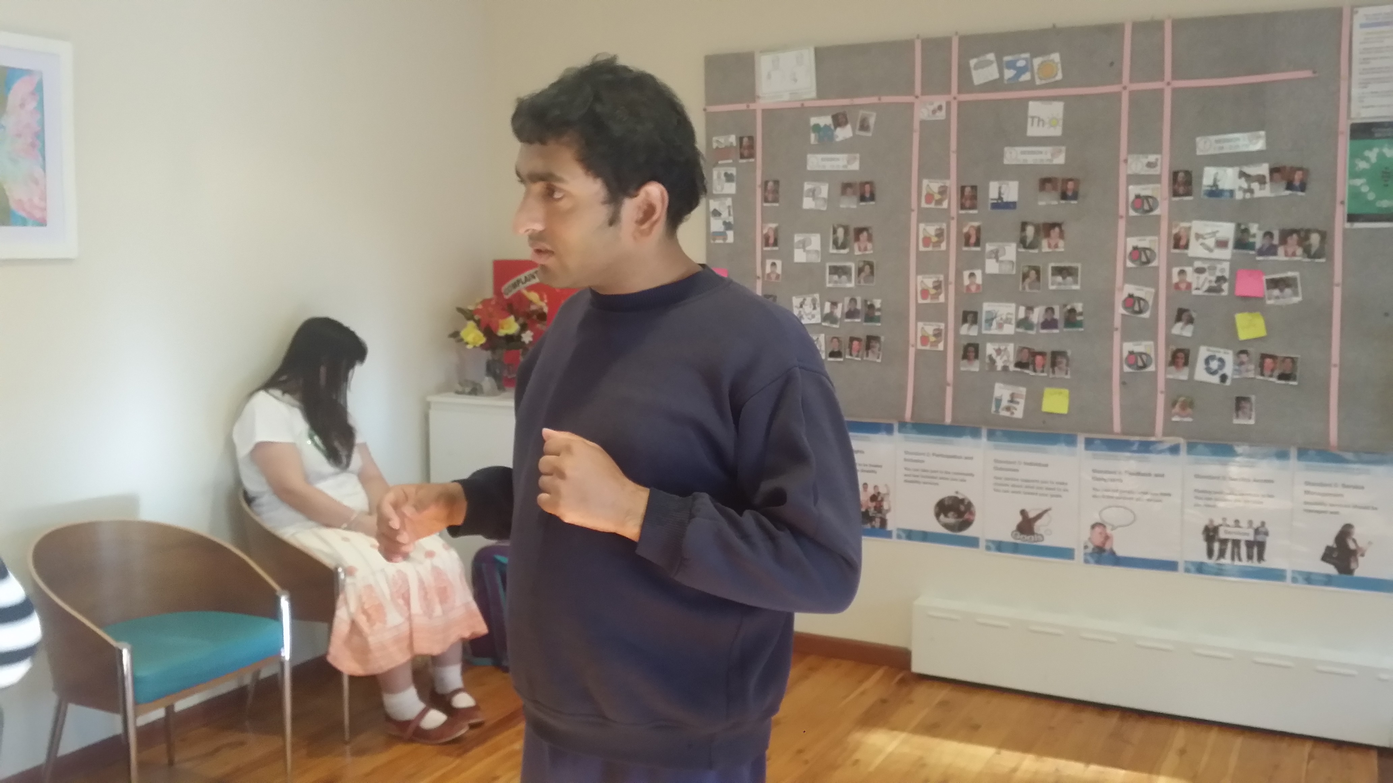
Introduction
Hi, I am Sid Chandran. I am a non-speaker. I am autistic and use AAC to communicate. My fun things are - I like going for walks, visiting cafes and staying outdoors. I'm working towards becoming more independent. I have written some articles and a book about my experience with autism.
I feel grateful for the opportunity to talk to you.

Slide 3
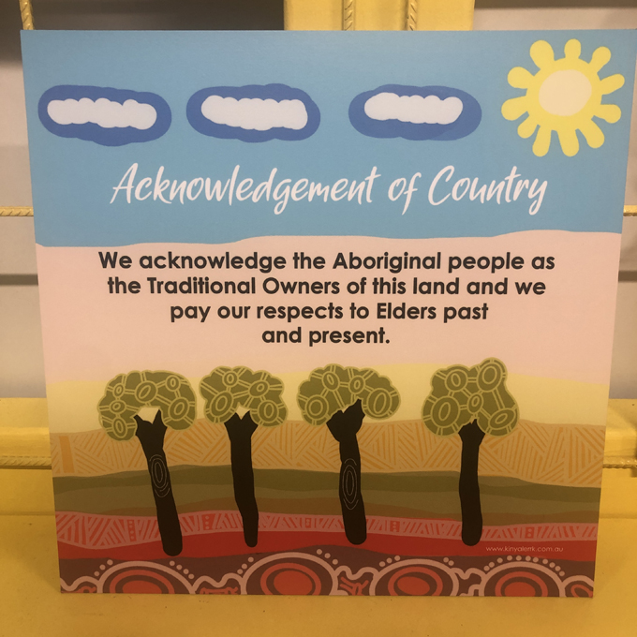
Acknowledgment
I acknowledge the country and culture of the land we are meeting on and pay my respects.

Slide 4
My Schooling

Slide 5
Early Years
I attended an autistic school to age 7. I spent the rest of my school life in special schools. I have few memories of my early years.

Slide 6
Special Schools
But overall, in special schools, I felt that teachers didn’t support my learning or behaviour. They used to get frustrated with my anxiety. I don’t think that Autism was well understood. I do remember one teacher in the private school that I attended for five years from age 12 who taught History. I thought he was good, and I enjoyed studying History.

Slide 7
Being a Boarder
My mother had to return to work. Those days there was little regular respite. So she put me in a boarding school where I spent five years. I was isolated from my natural environment. I am often asked what it was like to be a boarder. I am going to be honest. I was left to fend for myself. I was fearful that I would be assaulted. This was a setback.

Slide 8
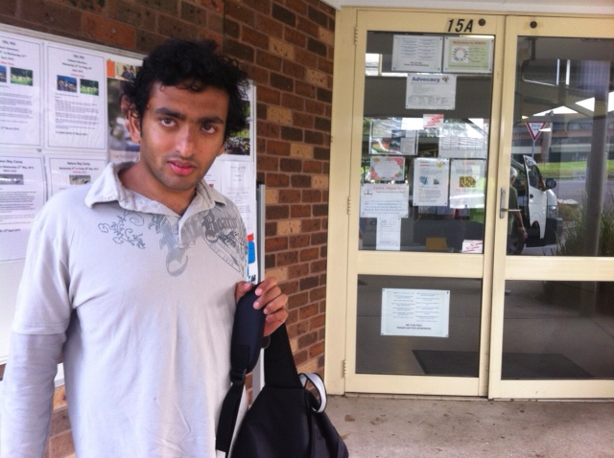
The Right to Communicate
Even at this private school I was in no way taught any communication system. I was offered a moderate academic curriculum. I enjoyed history and poetry. School was not stimulating. I was bored with school. At neither of the special schools did they try to set me up with a communication system.

Slide 9
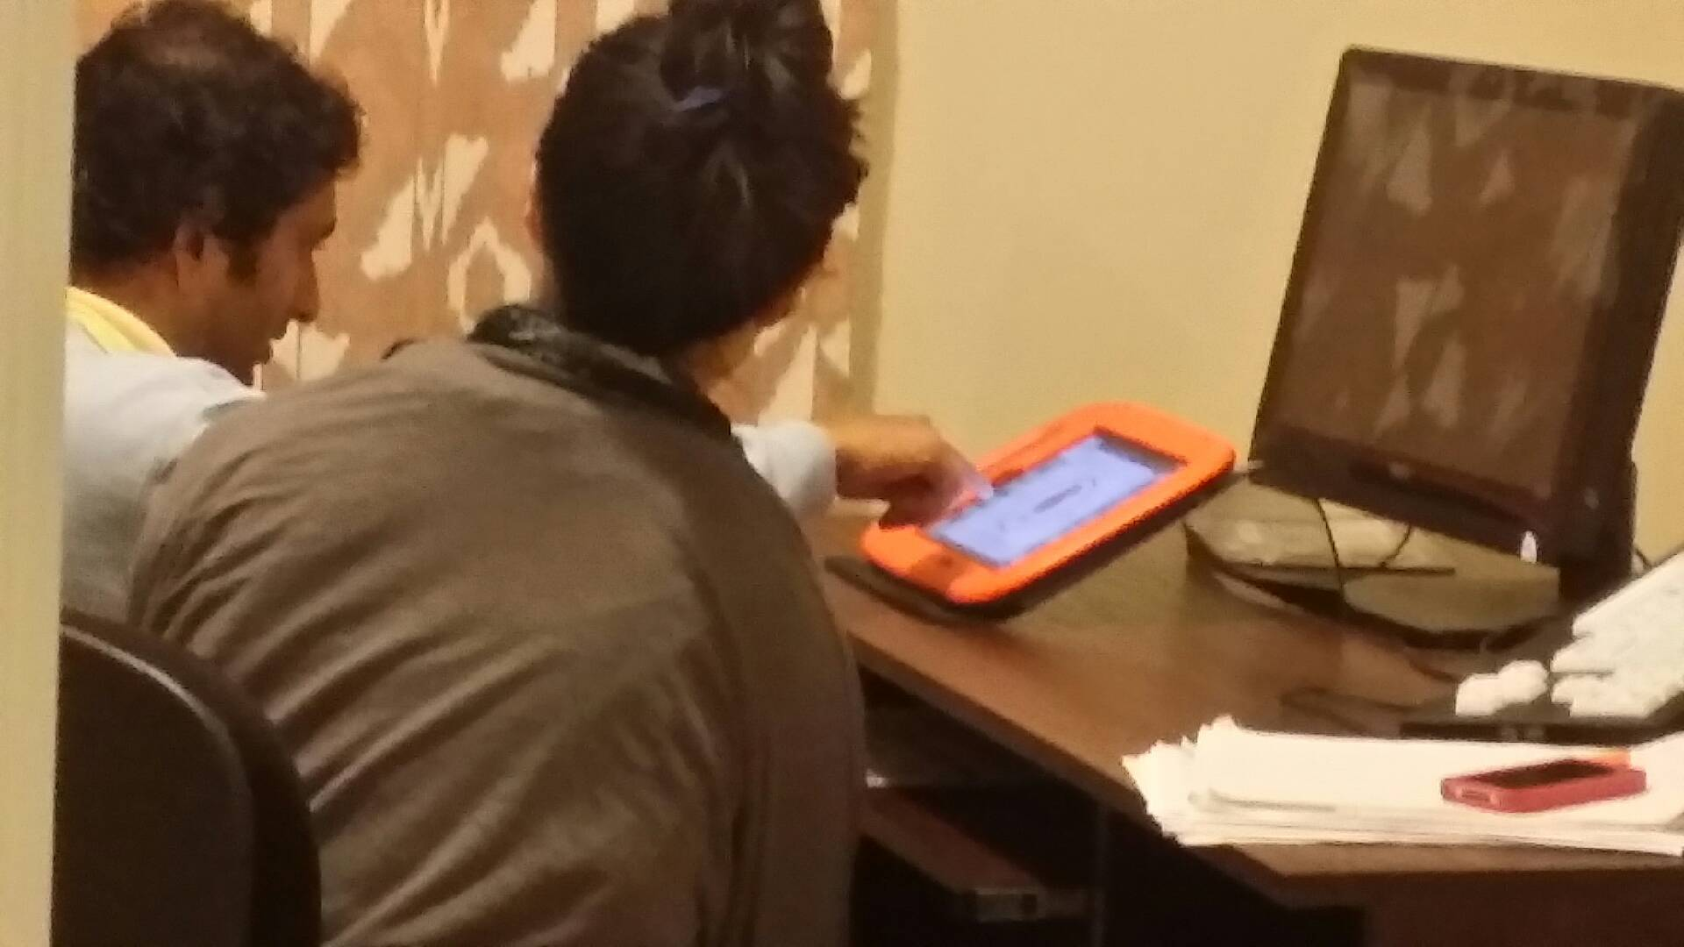
Literate at Last
At that time, I had not communicated to others that I had literacy skills. The schools assumed that I was intellectually impaired. Because of this I don’t think I was educated in a regular method of teaching. I wish I had been mainstreamed.

Slide 10
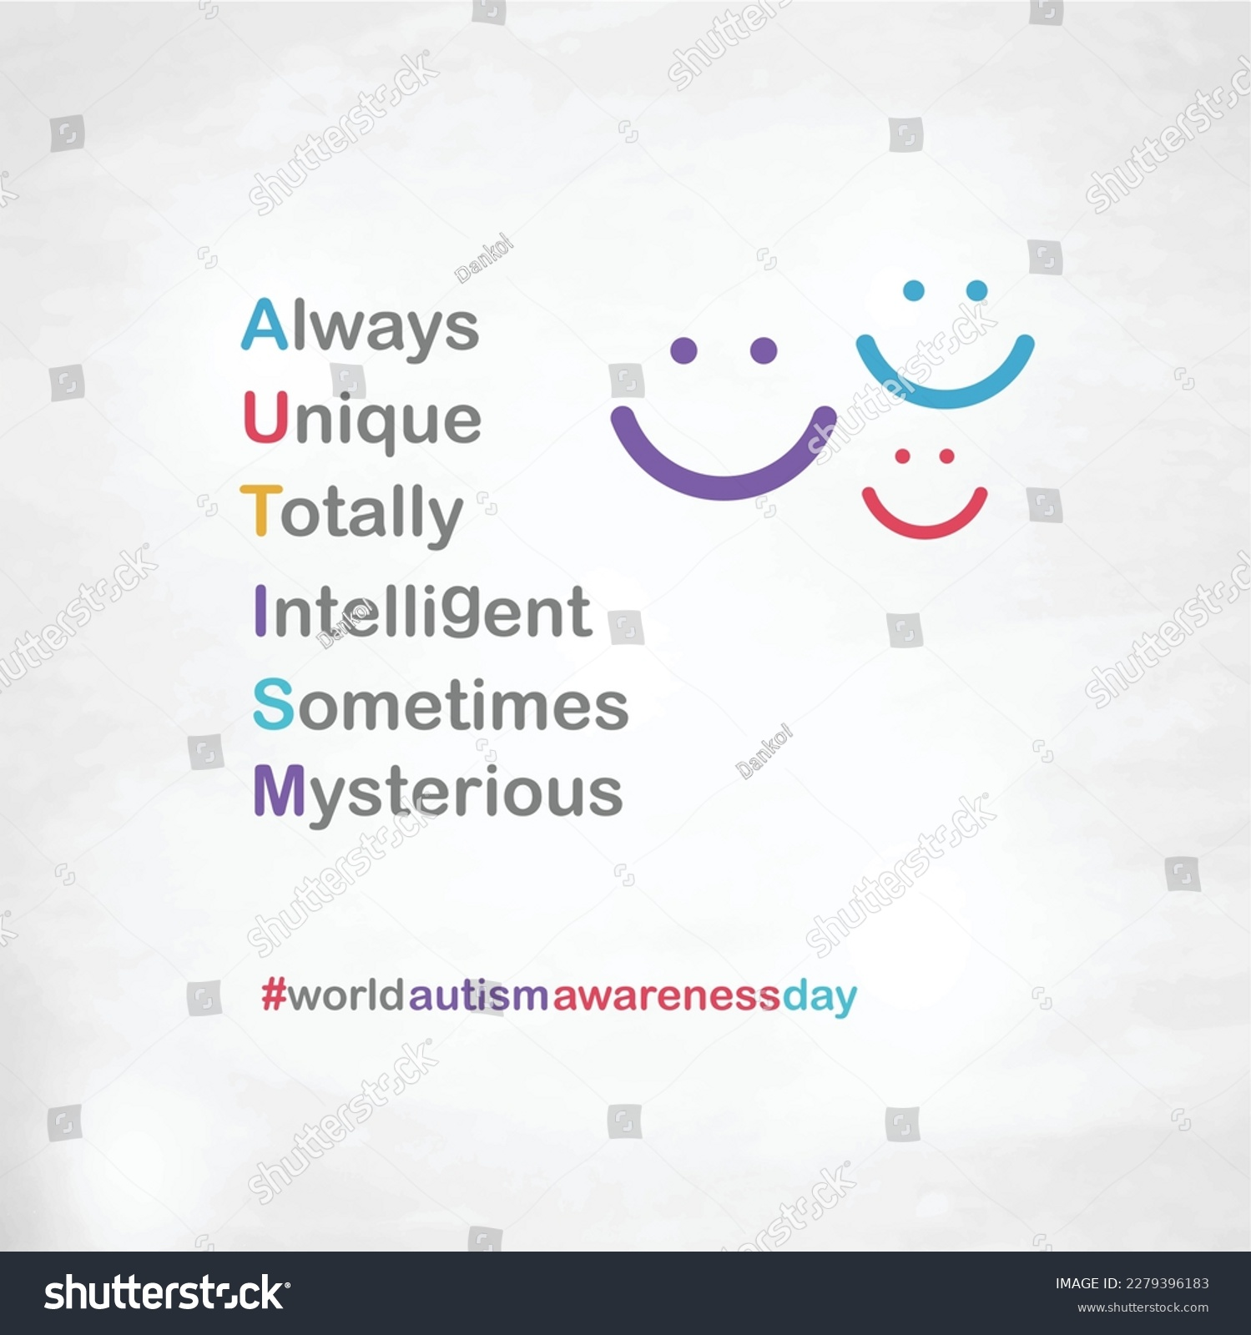
Presume Competence!
Overall, my experience would have been better if a presumption of intelligence was made.

Slide 11
A Unique Disability
My mother has said that I attended a school for autistic children till I was seven years old. Her understanding is that once children left childhood, autistic schools either mainstreamed them or sent them off to special schools. We don’t know if things have changed since then. Even at that time paediatricians were against moving children with autism to special schools as they did not think that autism could be addressed there. They felt that the combination of strengths and weaknesses that people like me experience cannot be handled in special schools. But there was pressure brought on families.

Slide 12
Autism is Complex

Slide 13
A National Strategy
Lately there is recognition that autism is a separate disability that cannot be covered under a general disability approach. I am hopeful that a national autism strategy will help.

Slide 14
Missing Piece- Education!
Lack of understanding of autism has many consequences. One of the consequences is not imparting a proper education to people with autism, specifically for people like me whose autism masks their intelligence. This has also prevented me from pursuing a career of my choice. This is the reason that we need to start with a position of presumption of competence.

Slide 15
The Role of AAC

Slide 16
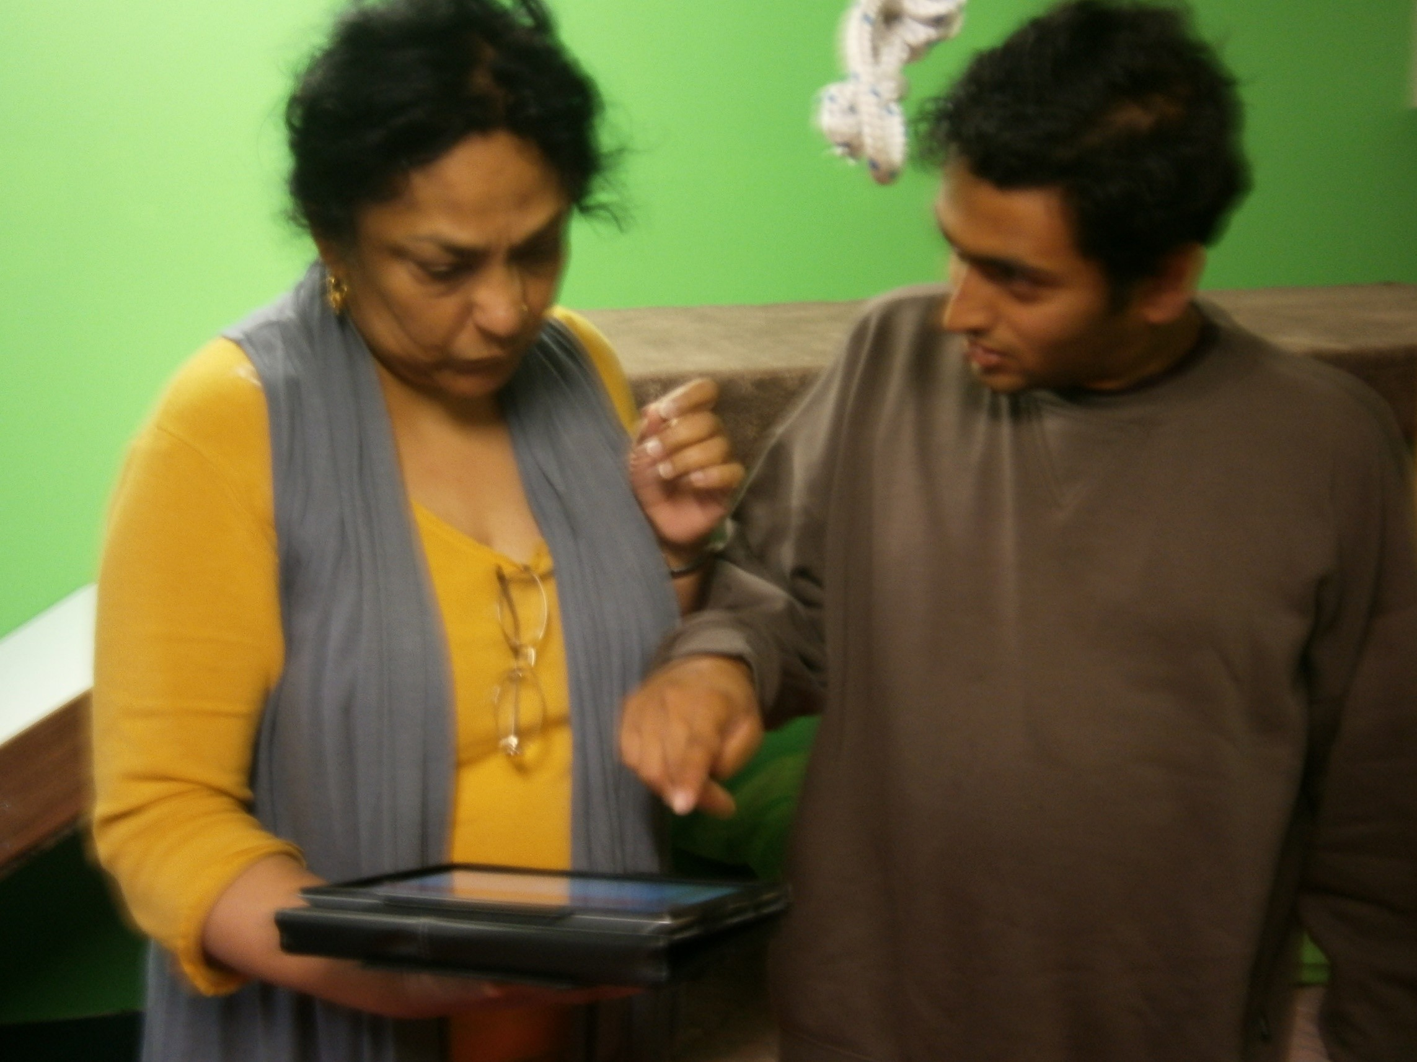
AAC Journey
My life opened up when my mother and I began to work on my typing and getting me on to an AAC device. By then I was in my teens.

Slide 17
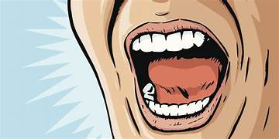
Urban Myth
At this time when we still have to prove to people that we don’t lack competence, AAC gives us a tool to demonstrate that we have as much to say as anyone else. Through AAC I am able to say ‘I am a non speaker but not a non-thinker.’
‘Not Being Able To
Doesn’t Mean I Have Nothing To Say

Slide 18
AI and Autism
I have great hopes for the future of all nonspeakers. I hope that they won’t need to demonstrate to schools and other services that they are deserving of all opportunities to learn and live their lives. This will happen once AAC users begin to spread the word about what vistas can open up with AAC.

Slide 19
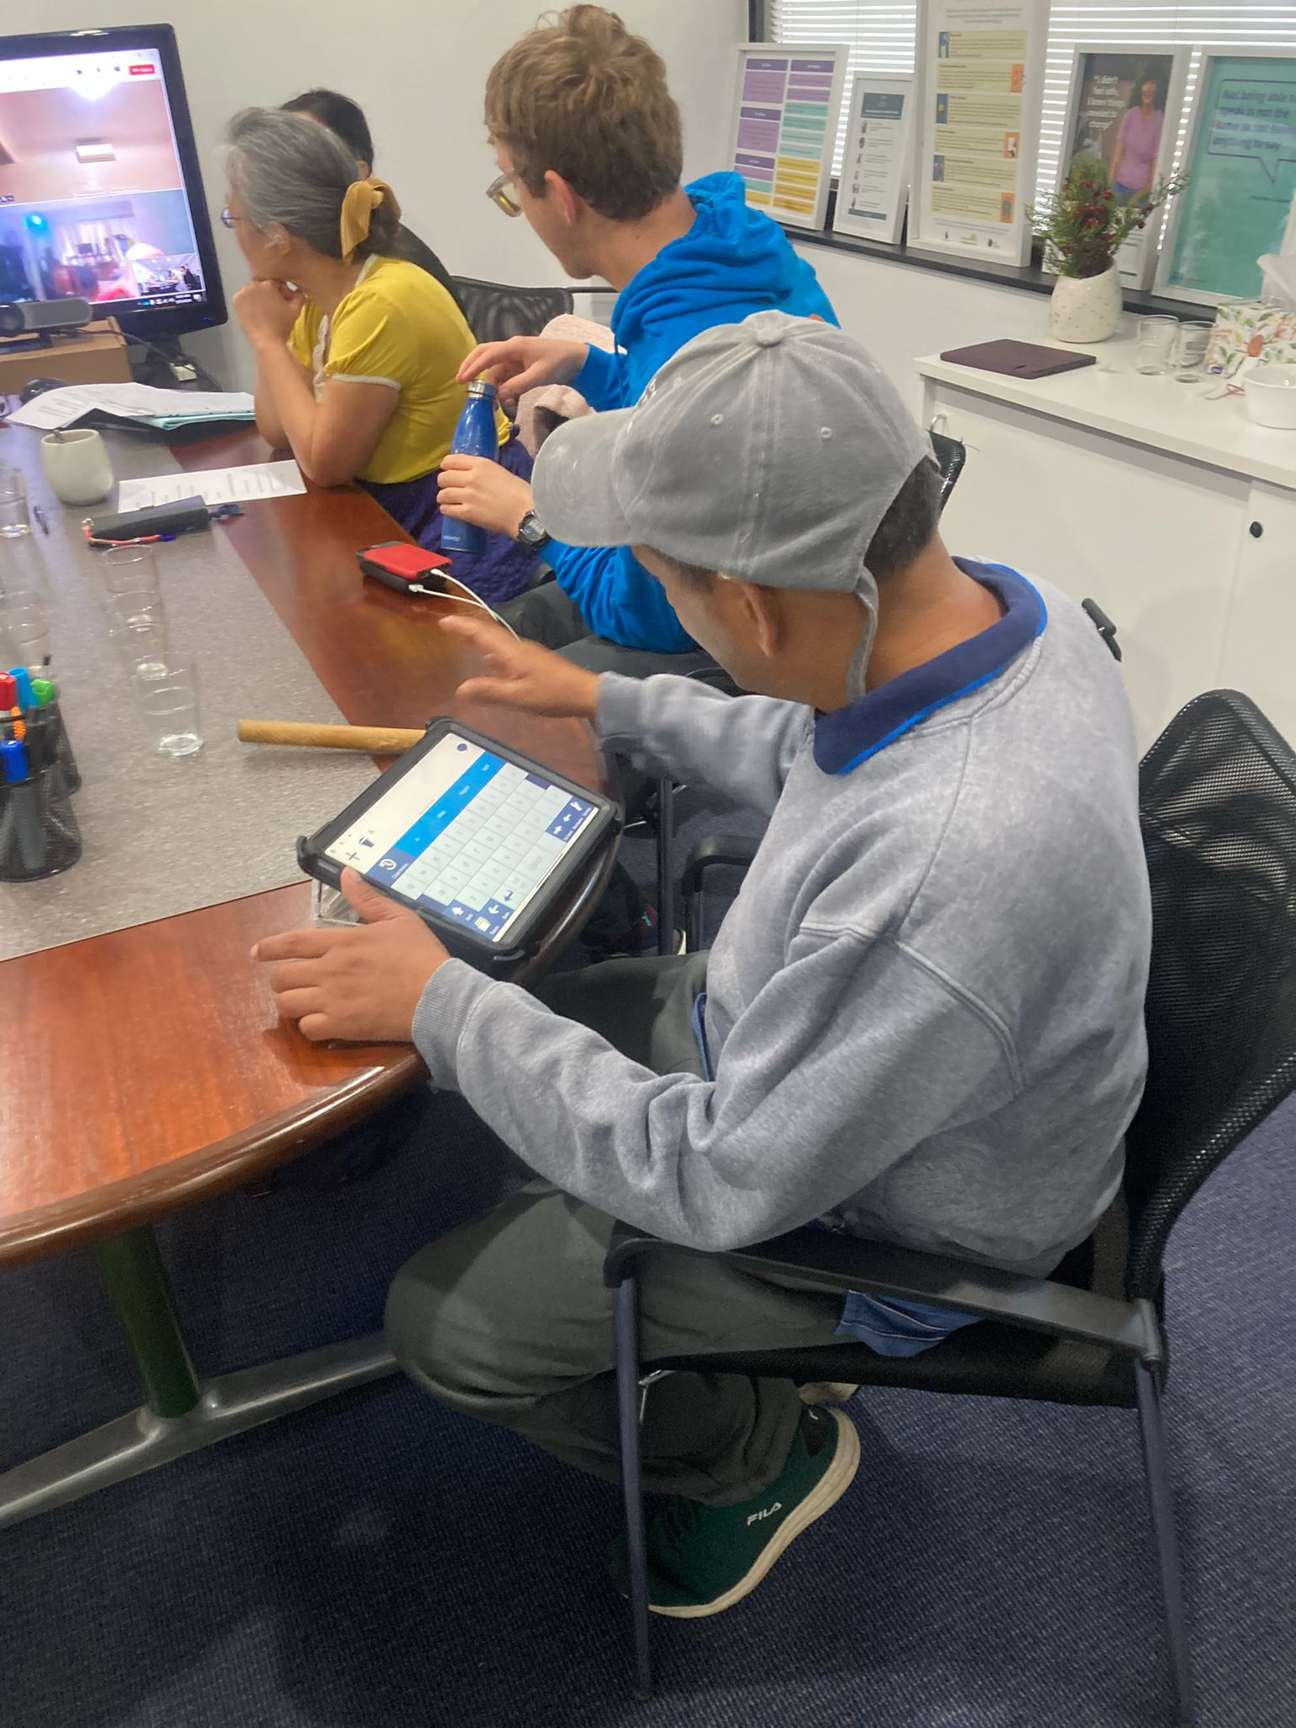
AAC is Good
Social connections, self-advocacy and self-achievement have been the main benefits of AAC.

Slide 20
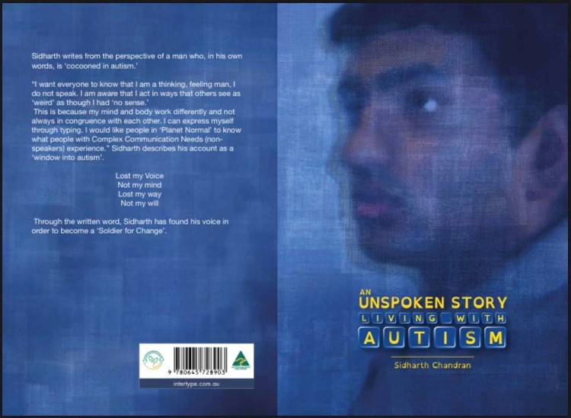
My Name in Print
It is hard to imagine that an autistic man who can’t tie his shoe laces would be a published author. That is the power of AAC because this autistic man wrote his book using AAC.

Slide 21
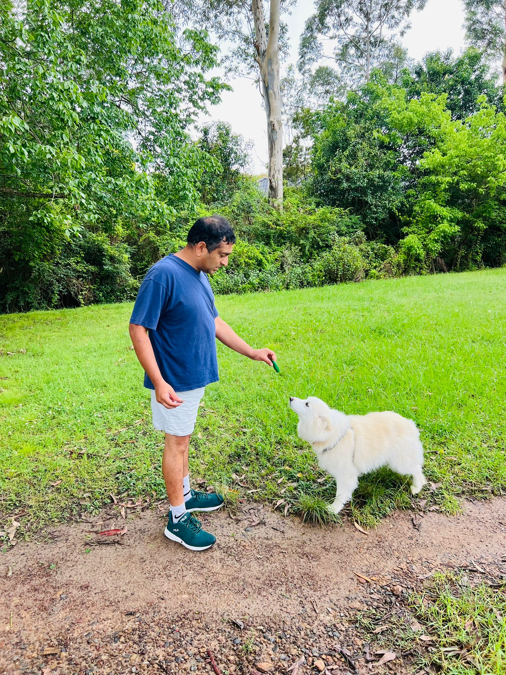
It is Looking Up
When I saw my name in print, it was the best thing that happened to me.
From being invisible I now have a presence.

Slide 22
My Daily Challenges

Slide 23
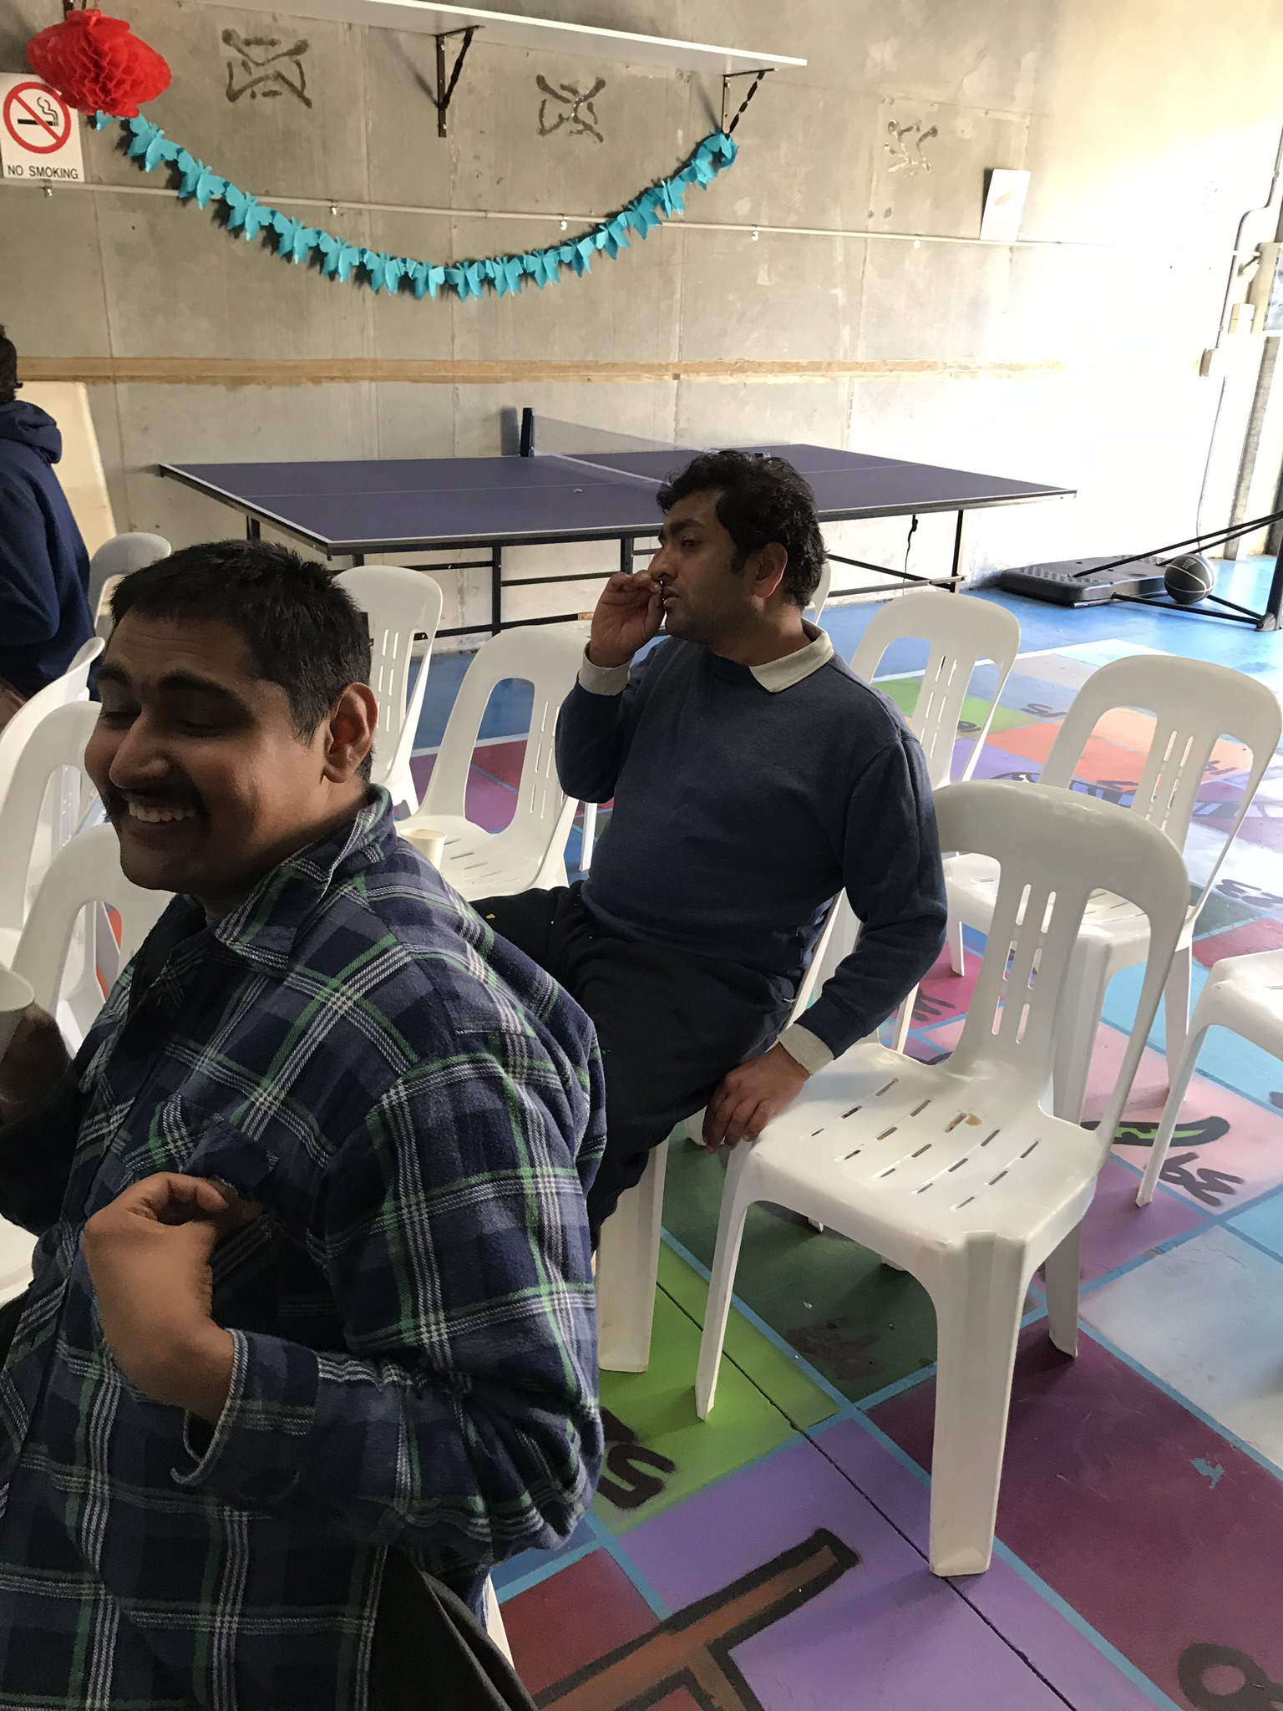
There Must Be A Better Way
There are challenges that I face every day. The accommodations that I need to interact and work in social spaces are time consuming for anyone wanting to interact with me. This has the impact of reducing the number of opportunities that are available for me to participate.
AAC has limitations. I have a hard time working with those limitations.

Slide 24
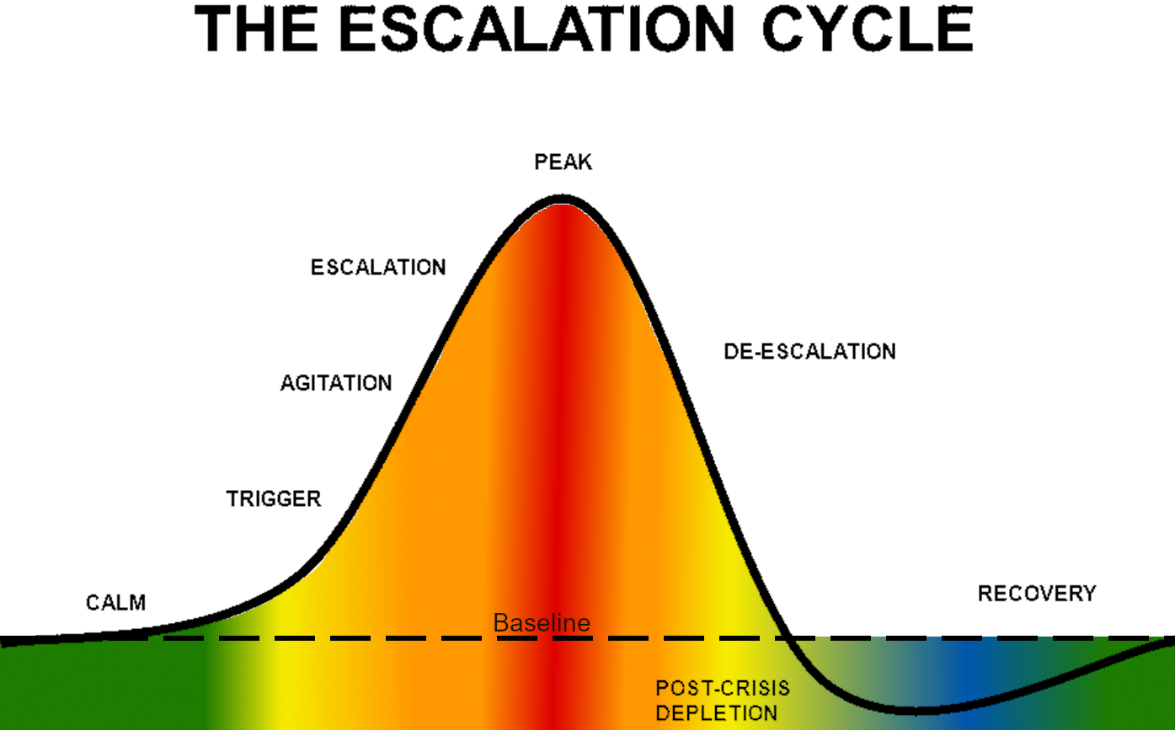
Ups and Downs of Behaviour
I communicate best when I am with a support person who knows me and cares.
However, I do not have that level of connection with most support workers. I don’t express myself well when I am with support workers whom I do not know.

Slide 25
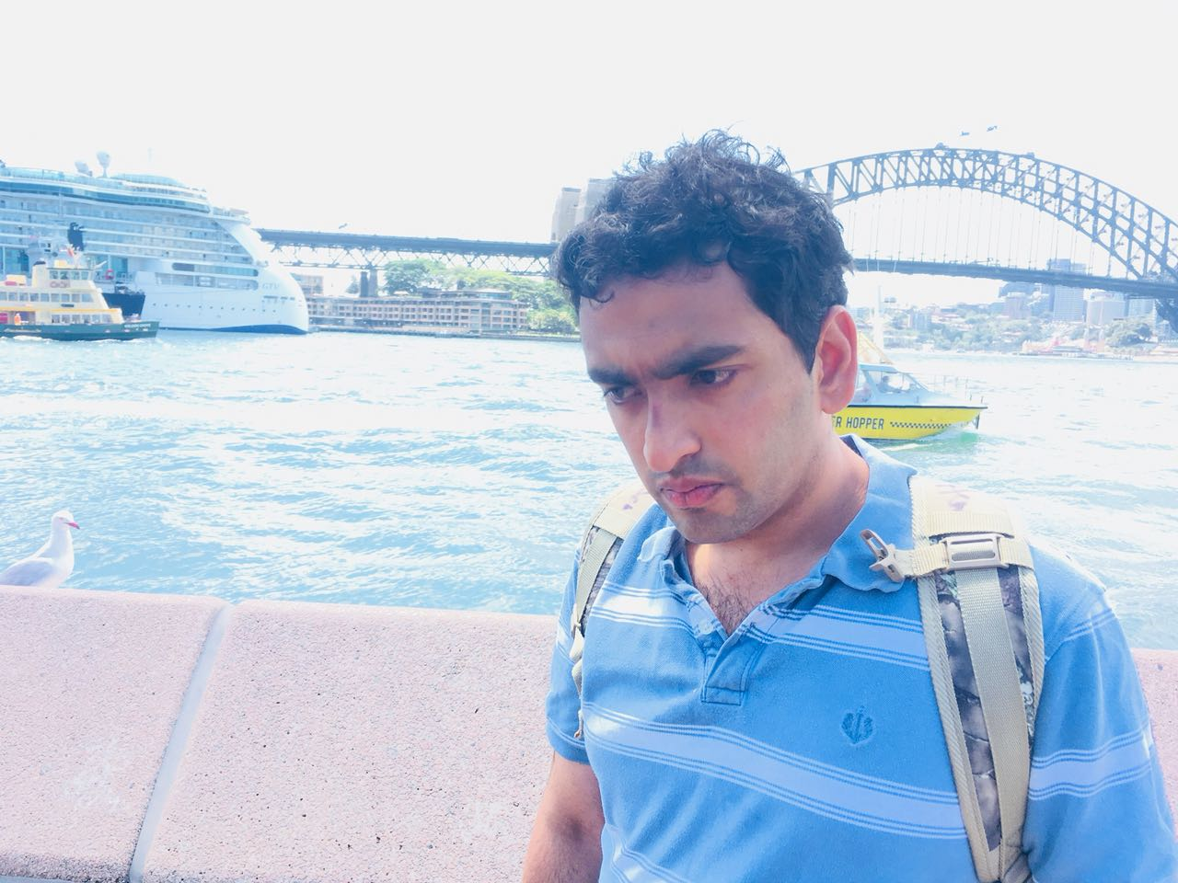
A Better Life
Having said that I have had great changes in the amount of time it takes me to get used to a new communication partner. This might be because I am getting better at self-regulation. I need to explore this issue more. I am always trying to work out what my support needs are. I am putting this in writing. I have also had a breakthrough of some kind. I have been able to type out phrases and sentences on my keyboard when I am working alone. This has happened only on rare occasions. But this is progress.

Slide 26
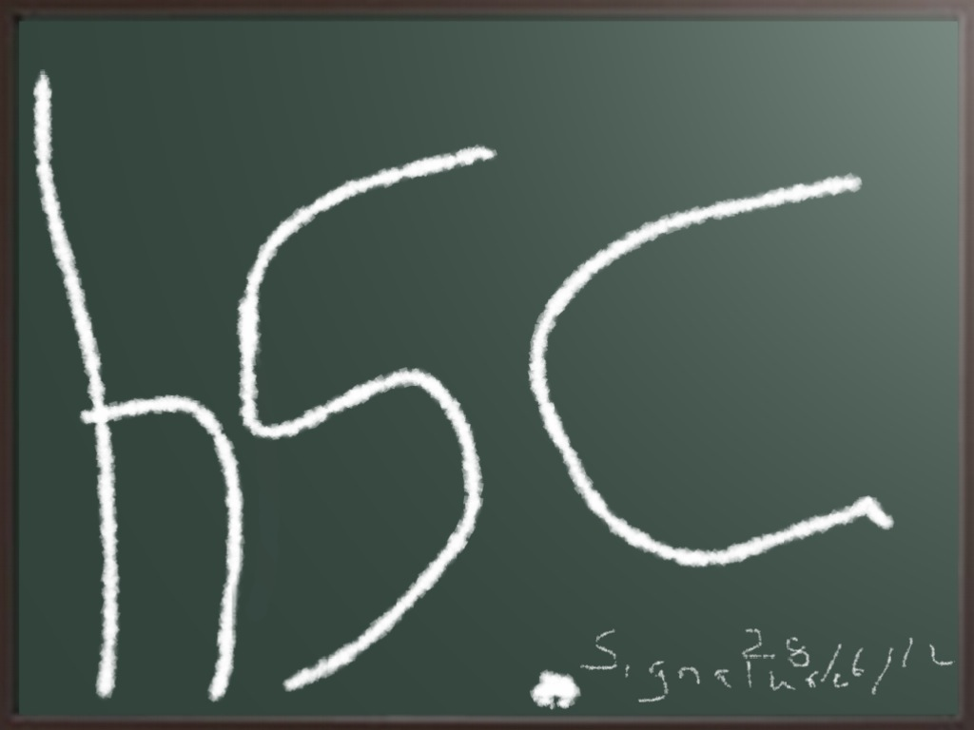
Signing Off
Thankyou for listening
I hope you enjoy the reading from my book and the videos on SDM.
My thanks to my friend and OT Natasha for helping me to make the presentation.

